Slide 1
SWOT and PORTER’S ANALYSIS
Group 2:
Abhijeeth Reddy Basani
Brendan Barker
Puneet Shetty
Rutwik Ghag
Shubhajeet Kulkarni

Slide 2
SWOT ANALYSIS

Slide 3
SWOT Analysis
STRENGTHS
Dedicated staff
Willingness to sacrifice
WEAKNESSES
Funding
Lack of resources
Lack of good leadership
Lack of exposure and expertise
Lack of initiative to collaborate
Network overload
S
W
OPPORTUNITIES
Collaboration with other universities
New system for learning analytics and educational data mining
THREATS
Cyber security
Students lack confidence in ITS
Dilemma to please the admin and the faculty
O
T

Slide 4
PORTER’S ANALYSIS

Slide 5
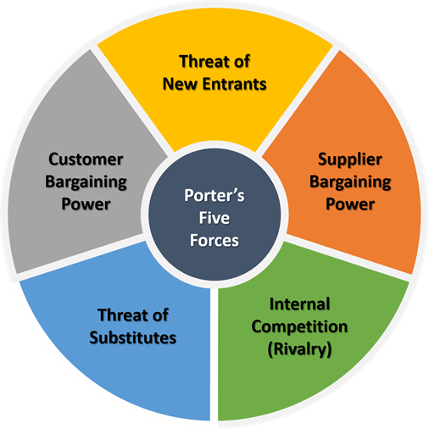
Porter's 5 Forces
1. Competition in the industry
2. Potential of new entrants into the industry
3. Power of suppliers
4. Power of customers
5. Threat of substitute products

Slide 6
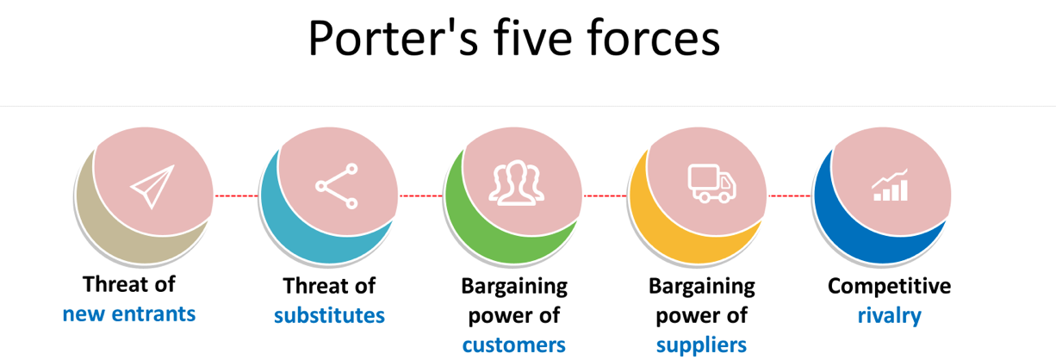

Slide 7

Bargaining power of buyers
we must analyze where the bargaining power of buyers is located within the industry. As student bodies have grown more global, the university's ability to control their enrollment has faded. Forces outside the control of the University control how many students can afford to travel and attend your institution. For example, many colleges enjoy full tuition from their international students, as their governments encourage their students to study at premier universities. However, this means that this particular population of students is controlled by how much their government is willing or able to spend, meaning no amount of marketing or campus attractions will secure these students' enrollment. Looking away from the international students, local prospects are increasingly worrying as well. Many students leaving high school are not attending prestigious higher institutions, not wanting to be saddled with student debt. They are instead looking for smaller universities where they can mitigate the amount of debt they accrue. This means the initial student experience has to be perfected. There cannot be technology issues, enrollment struggles, and a wider selection of education options must be offered. This falls on the ITS department to develop and design user friendly systems that provide plenty of options to a wider audience of students.

Slide 8
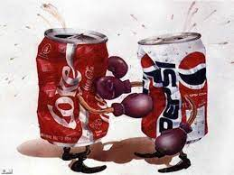
Threat of substitute products and services
we will look at the threat of substitute products and services. Students are rejecting the traditional four-year college model (Anderberg) and instead embracing alternative methods to seek their education. As previously stated, the higher cost of education is scaring students off, so many are adopting these other tactics to get their education or move into the business world. Universities are reluctant to change their current four-year model, as many of these alternative services are not financially profitable if the majority of students enrolled at an institution decide to take that path. This will only worsen as technology betters and independent educational programs siphon off more and more students seeking a narrower focus in their education.

Slide 9
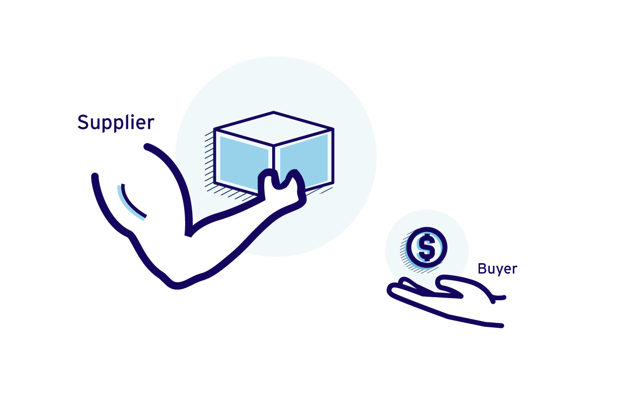
Bargaining power of suppliers
is the bargaining power of suppliers, which will, for our purposes, focus on the rapidly growing educator crisis. More and more educators seek higher pay or are moving to companies where their services will be better compensated. Universities are offering better pay and more benefits to combat this, but this is dragging many universities down as administrative costs swell and more educators leave. Enter the adjunct professor. Adjuncts are usually not full-time educators and instead are full-time professionals in their respective fields who teach on the side. These adjuncts are cheaper than regular educators, as they are not full-time instructors. Still, there is often a drop in quality (which is not necessarily the instructor's fault), the student and teacher experience suffers, and a much higher educator turnover rate. (Edmonds) This will inevitably lead to a revolving door of new teachers, leading to erratic student experiences, which will diminish the experience. This also becomes the problem of ITS, as they need to find ways to incorporate new instructors every year, and their various styles of teaching. As the adjuncts arrive with newer methods for teaching, ITS has to adapt systems to accommodate instructors unfamiliar with the current IT infrastructure, and retrofit existing systems to the new technology said instructors will be using to teach. New systems such as remote classrooms open up a Pandora’s box of where adjuncts can teach from, and when. These factors will have to be heavily considered when upgrading IT systems.

Slide 10

Threat of new entrants
we have the threat of new entrants. This can be broad, as not the same culprit will impact every degree program. There is, however, one common denominator that is slowly creeping up on universities—the threat of obtaining new credentials. On the surface, this might not seem like an issue, as many certifications are obtained after the college experience. However, many students, workers, and companies are realizing that with the age of technology, additional retraining, new certificates, and new degrees are needed. This is leading to many companies simply hiring fresh workers and providing them with the training, as that process will need to be done anyways, and the workers will constantly have to be learning new techniques. So why should they bother with higher education if it is going to just be forgotten and retaught five years down the line? This is a severe issue many institutions should be considering and reformatting their degrees to account for this growing trend. ITS will also have to accommodate students in obtaining credentials through new systems and programs, as well as making current systems adaptable for future credential acquisition requirements. Changing the content of a degree is hard enough, but fitting it within the IT system can create many new challenges such as security, ease of access, and negotiating agreements to host credential acquisition.

Slide 11
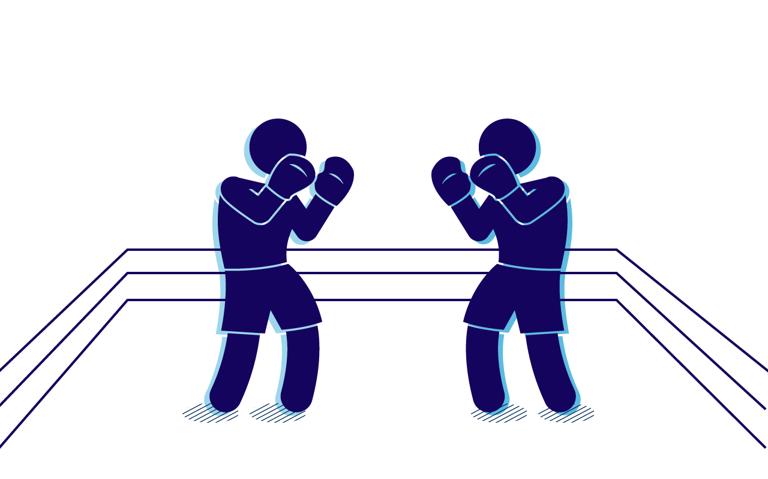
Character of rivalry
we have the character of rivalry that is likely the most significant determining factor as to why enrollment is falling. Since the 1980s, there has been a drastically huge uptick in new colleges and universities opening their doors, from 1957 institutions in 1981 to over 3000 in 2013. This massive increase, however, does not correlate with student body growth, as the prospective student body has largely remained the same over the past three decades. This means there are far more mouths to feed institution-wise, but the student fuel is becoming scarcer and scarcer. This means that the IT infrastructure must remain scalable, especially if student usage is projected to continually decrease. The quality of the system must remain intact, but the usage of the system must be properly calibrated for lower student counts, and easily upgraded if there is ever a huge bounce in enrollment.

Slide 12
What this means for the future of MAC University
What does all of this mean for the future of MAC University and the ITS department? Essentially it boils down to 3 things the university must do to raise enrollment while maintaining secure strong ITS systems. New markets of students must be reached, administrative costs must be lowered without sacrificing quality, and the cost to the students' needs to be modified/degrees need to be altered to fit the modern setting. ITS’ role in each of these is that they must make the prospective/new student experience as good as possible, effective scalable IT systems need to be implemented, and alternative forms of credential acquisition/education need to be incorporated into current systems. There will be challenges, but these are not impossible if appropriately approached and considered all the industry's current factors. A plan to counter the rising storm the collegiate industry is slowly wading into must be set in place as efficiently and as effectively as possible.

Slide 13
Thanks!
Any questions?

